Slide 1

Women Safety Analytics: Protecting Women from Safety Threats
Empowering women through real-time crime data and safety tips. Building a machine learning system to boost safety in cities.

Slide 2

Introduction: Addressing a Critical Need
Urban Safety Concern
Current Solutions
Women face rising risks in urban areas worldwide.
Often reactive, lacking predictive capabilities.
Our Approach
Goal
Uses predictive analytics and real-time assistance.
Reduce incidents and empower informed choices.

Slide 3
Problem Statement: The Challenge
Real-Time Data Gap
Response Inefficiency
Safety info is often outdated or inaccessible.
Emergency responses average 15 minutes delay.
Under-reporting
Limited Personalization
Fear and stigma cause many to stay silent.
Safety advice is generic, not location-specific.

Slide 4
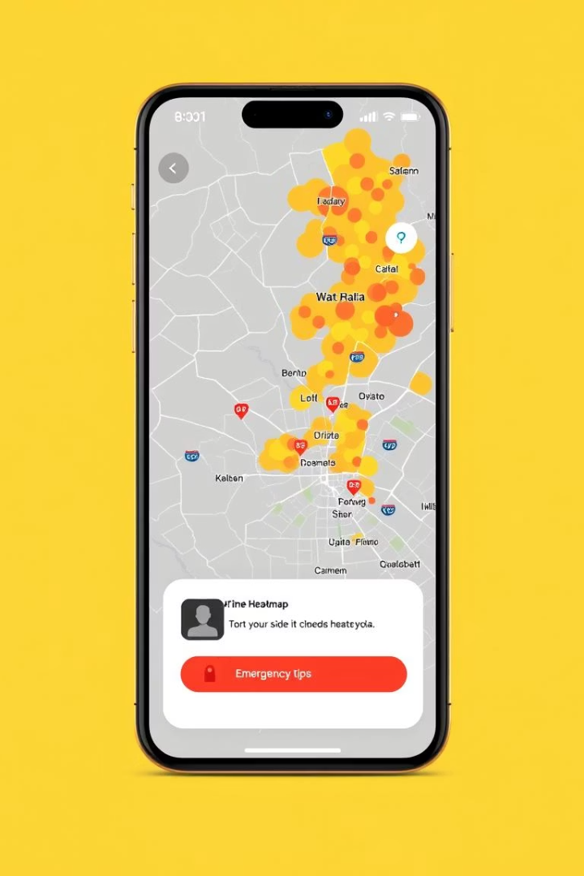



Key Features: Empowering Safety
Real-Time Crime Data
Safety Score
Chatbot Assistance
ML risk assessment by location.
Hourly police updates.
Instant help and reports.
Emergency SOS
Direct emergency contact with location.

Slide 5





Technology Stack: Building a Robust System
Python & TensorFlow
ML model creation and training.
Flask API
Real-time data access.
PostgreSQL
Secure data storage.
React Native & AWS
Mobile app and scalable cloud deployment.
Initial investment $50k; $10k annual maintenance.

Slide 6
How the Chatbot Works: Immediate Assistance
NLP Understanding
1
Interprets user queries naturally.
Real-Time Support
2
Provides safety tips instantly.
Emergency Integration
3
Connects with local services fast.
Personalized Risk
4
Tailored advice using location data.

Slide 7

Challenges: Navigating the Road Ahead
Data Privacy
Protect user anonymity and data security.
Algorithm Bias
Address potential inequities in ML models.
System Integration
Ensure smooth police API compatibility.
User Adoption
Encourage widespread engagement and trust.

Slide 8

Conclusion: A Safer Future for Women
Proactive Solution
Empowers women with real-time information.
Scalable Model
Builds safer communities sustainably.
30% Incident Reduction
Projected decrease in 2 years.
Call to Action
Support investments in women’s safety.

Slide 9


